Slide 1

Deutsche-Indo Bank
Prediction of Approval of Credit Card Application

Slide 2
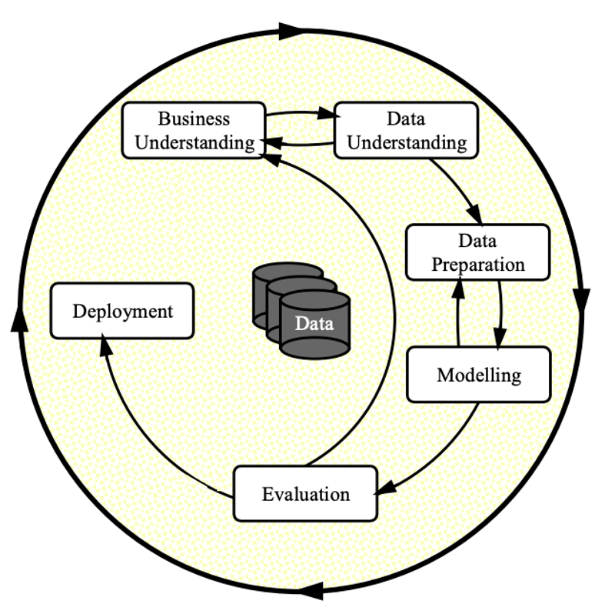
Data Science Principles Utilized

Slide 3
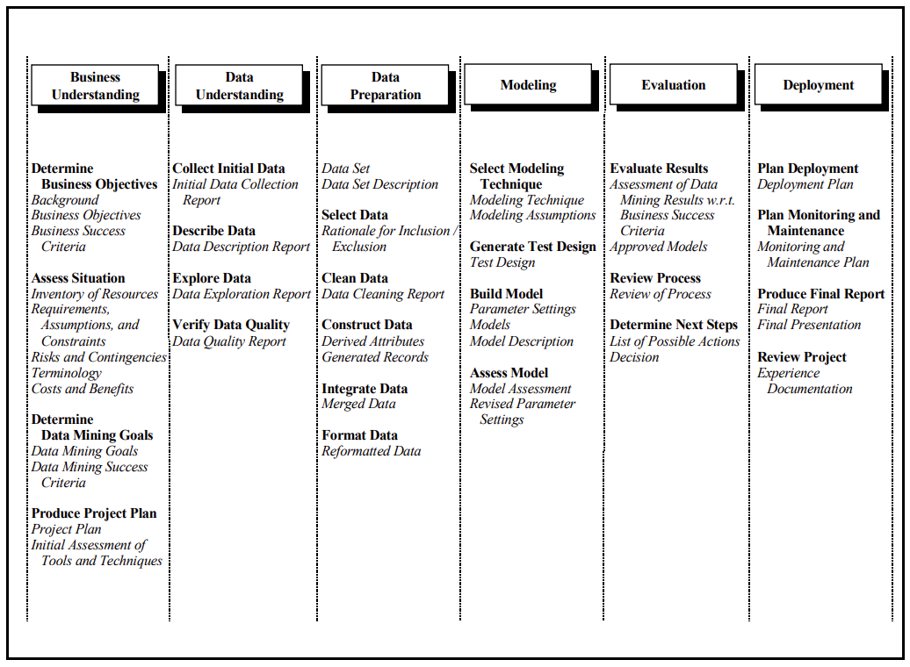
A Step-by-step Approach

Slide 4

Problem Statement and Objectives
Build a model to predict if an applicant is ‘good’ or ‘bad’ client.
Credit Card application is approved based on various demographic, social, and economic features.
Key tasks include feature selection, model training, and validation to ensure the model accurately captures the relationship between user attributes and their importance.

Slide 5
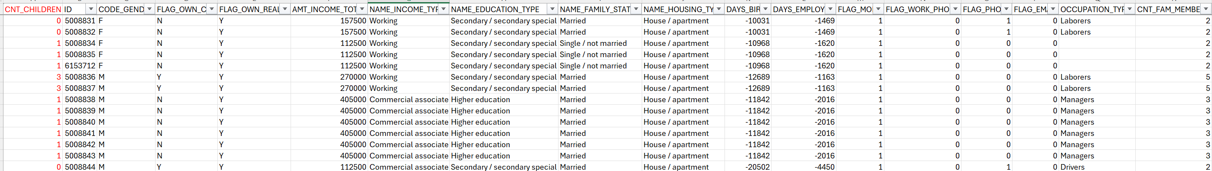
Prediction Drivers: (1) Applicant’s count of children

Slide 6
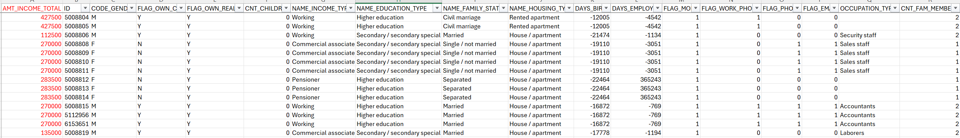
Prediction Drivers: (2) Applicant’s income

Slide 7
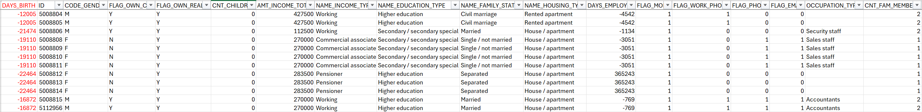
Prediction Drivers: (3) Applicant’s Age in Days

Slide 8
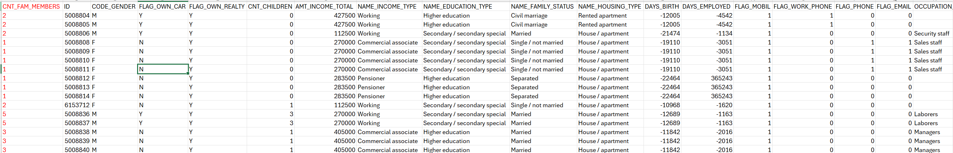
Prediction Drivers: (4) Applicant’s Family Size

Slide 9
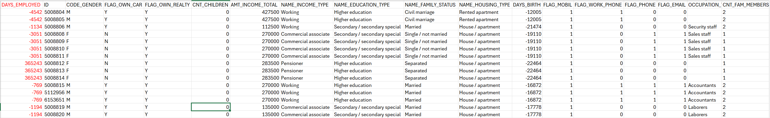
Prediction Drivers: (5) Applicant’s Employment in Days

Slide 10
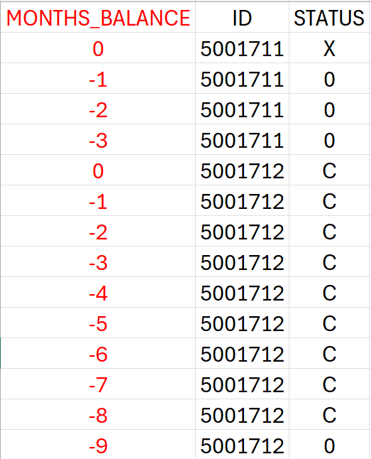
Prediction Drivers: (6) Applicant’s Outstanding Balance in Months

Slide 11
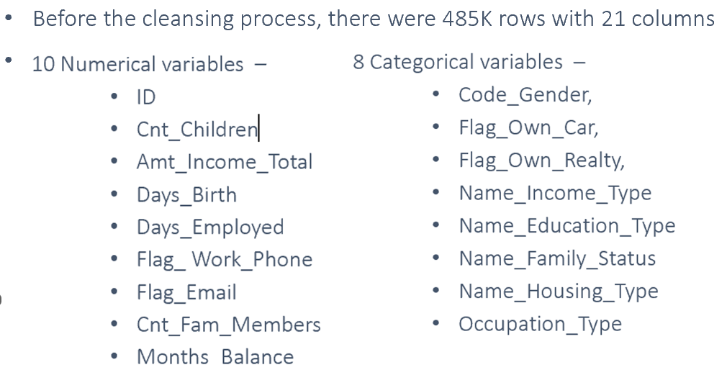
Data Cleansing
There is one column [Occupation_type] with nearly 30% of data that is null. So, this column was dropped from modeling.
There were no outliers that were detected.
There were no duplicates that were detected.

Slide 12
Data Processing
Machine Learning Techniques used:
Label encoding
Train/Test/Split the data to (train – 90% & test – 10%)

Slide 13

Data Modeling
Machine Learning Models used:
Random Forest Classifier
Logistic Regression
K-Nearest Neighbors
Decision Trees
The models were ready to be operationalized for frequent inferencing.

Slide 14
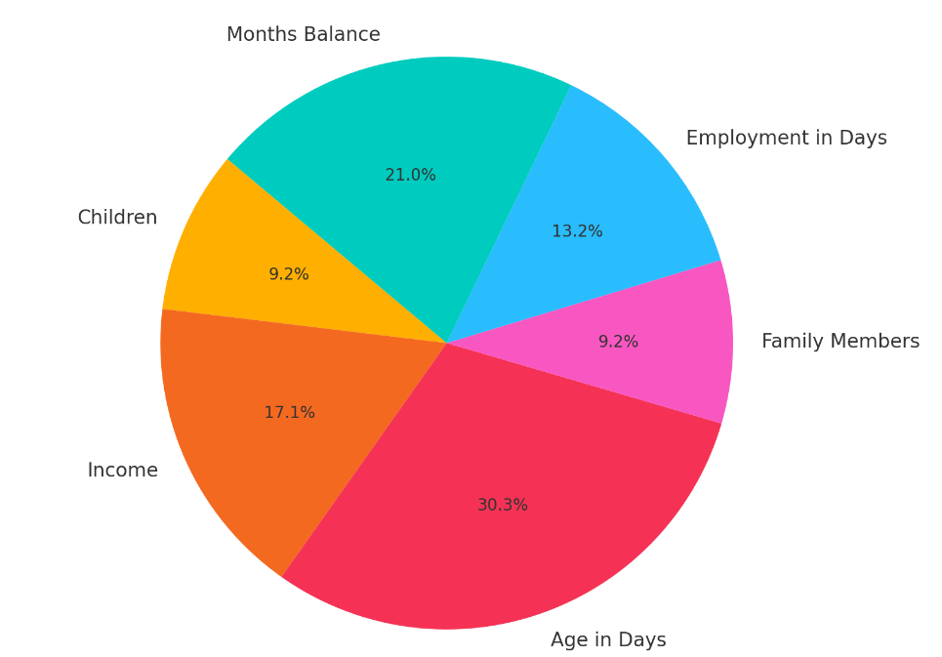
Feature Importance using Random Forest

Slide 15

Process Summary
By performing different ML models, we aimed to get a better results with minimal error and maximum accuracy.
Our purpose was to predict the effectiveness of using various demographic information in determining the approval of credit card application.
The data visualization features were explored deeply and the correlation between the features was examined.
Subsequently, ML models were implemented to predict the likelihood of an applicant getting credit approved.

Slide 16
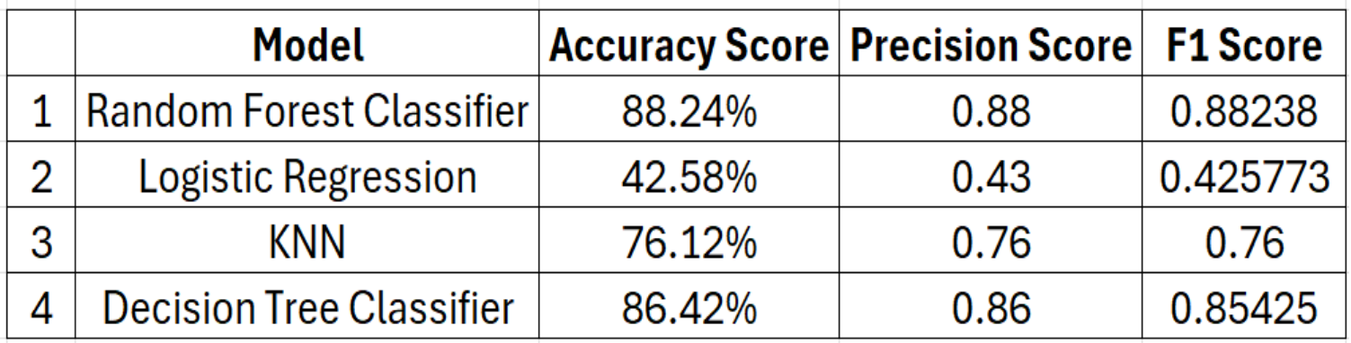
Model Score Summary
Out of the 4 models, the Random Forest Classifier model performed relatively better with 88% of Accuracy score. The nature of the data is such that the relationships between features and the target variable are non-linear or complex, making models like Random Forest and Decision Tree more suitable. Other models have achieved around 80% test accuracy, so the choice depends on the trade-off between training time and model complexity

